Slide 1
Chapter 5
Relational Algebra and SQL

Slide 2
Relational Query Languages
Database query language
  Languages for describing queries on a relational database
  A special-purpose PL designed for retrieving information stored in a database
Structured Query Language (SQL)
  Predominant application-level query language
  Declarative
    “declare” what information the answer should contain, not how to compute it (Specify the properties of the information to be retrieved but not the detail algorithm)
Relational AlgebraIntermediate language used within
  DBMS
    SQL statements are translated to before they are optimized
  Procedural
1-<number>

Slide 3
What is an Algebra?
A language based on operators and a domain of values
  Operated on relations (tables)
    A query is just an expression involving these operators
Operators map values taken from the domain into other domain values
Hence, an expression involving operators and arguments produces a value in the domain
When the domain is a set of all relations (and the operators are as described later), we get the relational algebra
We refer to the expression as a query and the value produced as the query result
1-<number>

Slide 4
Relational Algebra
Domain: set of relations
Basic operators: select, project, union, set difference, Cartesian product
Derived operators: set intersection, division, join
Procedural
  Relational expression specifies query by describing an algorithm (the sequence in which operators are applied) for determining the result of an expression
    Usually leads to a rather simplistic, inefficient algorithm
  Query optimizer
    Convert this algebraic expression into one that is equivalent but that takes less time to execute
    Query execution plan
1-<number>

Slide 5
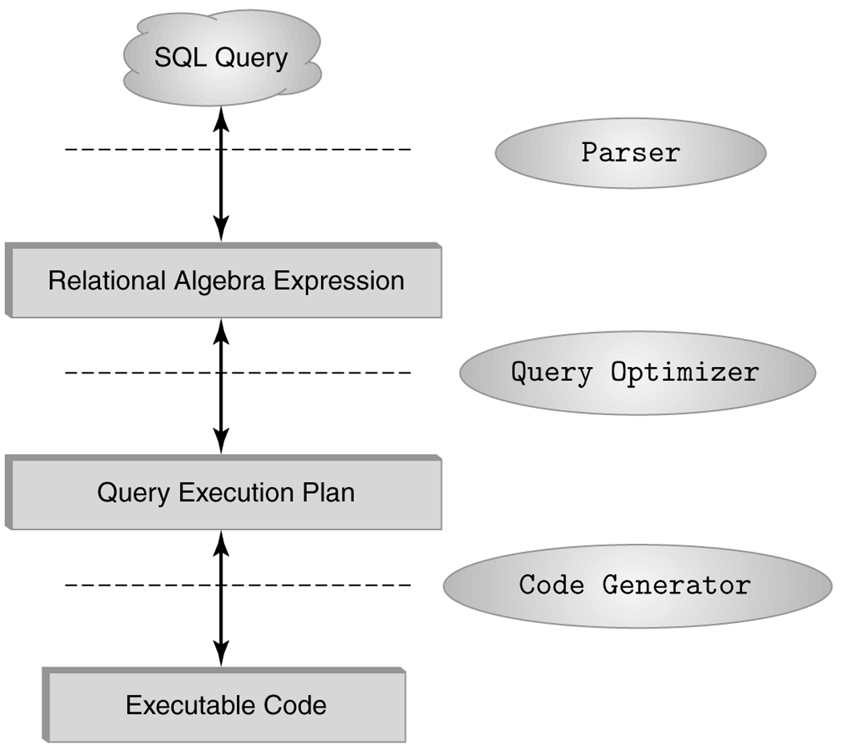
The Role of Relational Algebra in a DBMS
1-<number>

Slide 6
Select Operator
Produce table containing subset of rows of argument table satisfying condition
    Selection of a subset of tuples
σ_{condition} (relation)
Example:
  Person σ_{Hobby=‘stamps’}(Person)
Id Name Address Hobby
Id Name Address Hobby
1123 John 123 Main stamps
1123 John 123 Main coins
5556 Mary 7 Lake Dr hiking
9876 Bart 5 Pine St stamps
1123 John 123 Main stamps
9876 Bart 5 Pine St stamps
1-<number>

Slide 7
Selection Condition
Comparison operators: <, ≤, ≥, >, =, ≠
Simple selection condition:
  <attribute> operator <constant>
  <attribute> operator <attribute>
    Must be one of the attributes in the relation-name
<condition> AND <condition>
<condition> OR <condition>
NOT <condition>
1-<number>

Slide 8
Selection Condition - Examples
σ _{Id>3000 OR Hobby=‘hiking’} (Person)
σ _{Id>3000 AND Id <3999} (Person)
σ _{NOT(Hobby=‘hiking’)} (Person)
σ _{Hobby≠‘hiking’} (Person)
1-<number>

Slide 9
Project Operator
Produces table containing subset of columns of argument table
  π_{attribute list} (relation)
Example:
  Person π_{Name,Hobby}(Person)
Id Name Address Hobby Name Hobby
1123 John 123 Main stamps
1123 John 123 Main coins
5556 Mary 7 Lake Dr hiking
9876 Bart 5 Pine St stamps
John stamps
John coins
Mary hiking
Bart stamps
1-<number>

Slide 10
Project Operator
Example:
  Person π_{Name,Address}(Person)
Id Name Address Hobby
Name Address
1123 John 123 Main stamps
1123 John 123 Main coins
5556 Mary 7 Lake Dr hiking
9876 Bart 5 Pine St stamps
John 123 Main
Mary 7 Lake Dr
Bart 5 Pine St
Result is a table (no duplicates); can have fewer tuples
than the original
1-<number>

Slide 11
Expressions
Relational Expressions
  Just as in high-school algebra
π _{Id, Name} (σ Hobby=’stamps’ OR Hobby=’coins’ (Person) )
Id Name Address Hobby Id Name
1123 John 123 Main stamps
1123 John 123 Main coins
5556 Mary 7 Lake Dr hiking
9876 Bart 5 Pine St stamps
1123 John
9876 Bart
Result
Person
1-<number>

Slide 12
Set Operators
Relation is a set of tuples, so set operations should apply: ∩, ∪, − (set difference)
Result of combining two relations with a set operator is a relation
  All its elements must be tuples having same structure
  Hence, scope of set operations limited to union compatible relations
1-<number>

Slide 13
Union Compatible Relations
Two relations are union compatible if
  Both have same number of columns
  Names of attributes are the same in both
  Attributes with the same name in both relations have the same domain
Union compatible relations can be combined using union, intersection, and set difference
We also required union-compatibility for the difference and intersection operators
1-<number>

Slide 14
Example
Figure 5.2
Tables:
Person (SSN, Name, Address, Hobby)
Professor (Id, Name, Office, Phone)
are not union compatible.
But
π _{Name} (Person) and π _{Name} (Professor)
are union compatible so
π _{Name} (Person) - π _{Name} (Professor)
makes sense.
1-<number>

Slide 15
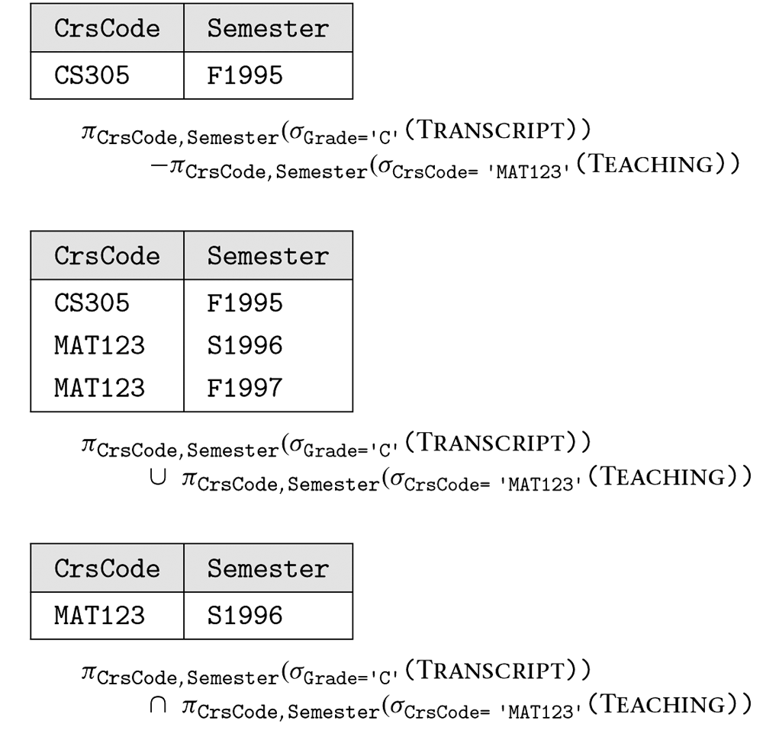
Figure 5.2 Examples of relational expressions that involve set operators.
1-<number>

Slide 16
Cartesian Product
If R and S are two relations, R × S is the set of all concatenated tuples <x,y>, where x is a tuple in R and y is a tuple in S
  R and S need not be union compatible
R × S is expensive to compute:
  Factor of two in the size of each row
  Quadratic in the number of rows
A B C D A B C D
x1 x2 y1 y2 x1 x2 y1 y2
x3 x4 y3 y4 x1 x2 y3 y4
x3 x4 y1 y2
R S x3 x4 y3 y4
R× S
1-<number>

Slide 17
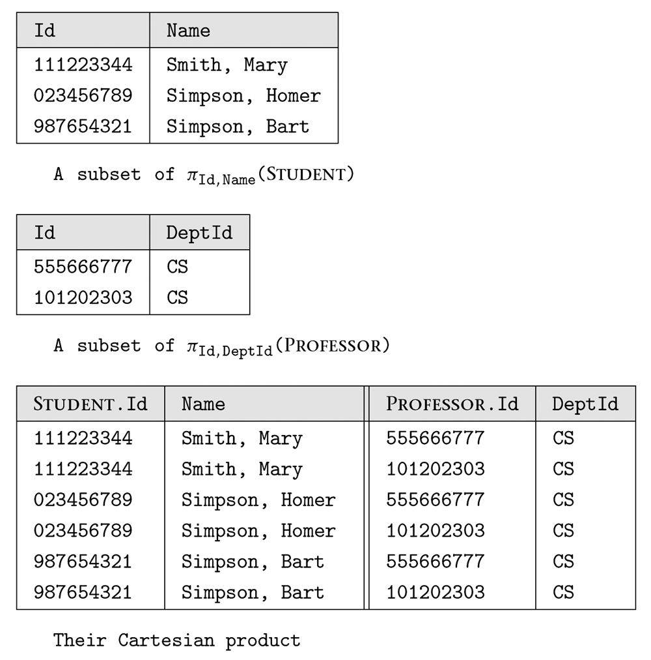
Figure 5.3 Two relations and their Cartesian product.
1-<number>

Slide 18
Renaming
Result of expression evaluation is a relation
Attributes of relation must have distinct names. This is not guaranteed with Cartesian product
  e.g., suppose in previous example a and c have the same name
Renaming operator tidies this up. To assign the names A₁, A₂,… A_{n} to the attributes of the n column relation produced by expression expr use expr [A₁, A₂, … A_{n}]
1-<number>

Slide 19
Example
Transcript (StudId, CrsCode, Semester, Grade)
Teaching (ProfId, CrsCode, Semester)
π _{StudId, CrsCode} (Transcript)[StudId, CrsCode1]
× π _{ProfId, CrsCode}(Teaching) [ProfId, CrsCode2]
This is a relation with 4 attributes:
StudId, CrsCode1, ProfId, CrsCode2
1-<number>

Slide 20
Derived Operation: Join
A (general or theta) join of R and S is the expression
R _{join-condition} S
where join-condition is a conjunction of terms:
A_{i} oper B_{i}
in which A_{i} is an attribute of R; B_{i} is an attribute of S; and oper is one of =, <, >, ≥ ≠, ≤.
The meaning is:
σ _{join-condition'} (R × S)
where join-condition and join-condition' are the same, except for possible renamings of attributes (next)
1-<number>

Slide 21
Join and Renaming
Problem: R and S might have attributes with the same name – in which case the Cartesian product is not defined
Solutions:
  Rename attributes prior to forming the product and use new names in join-condition´.
  Qualify common attribute names with relation names (thereby disambiguating the names). For instance: Transcript.CrsCode or Teaching.CrsCode
    This solution is nice, but doesn’t always work: consider
      R _{join_condition} R
      In R.A, how do we know which R is meant?
1-<number>

Slide 22
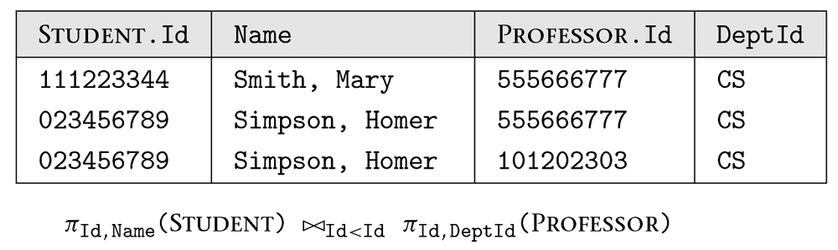
Figure 5.4 Join of relations in Figure 5.3.
1-<number>

Slide 23
Theta Join – Example
Employee(Name,Id,MngrId,Salary)
Manager(Name,Id,Salary)
Output the names of all employees that earn
more than their managers.
π_{Employee.Name} (Employee _{MngrId=Id AND Salary>Salary} Manager)
The join yields a table with attributes:
Employee.Name, Employee.Id, Employee.Salary, MngrId
Manager.Name, Manager.Id, Manager.Salary
1-<number>

Slide 24
Equi-join Join - Example
Equi-join: Join condition is a conjunction of equalities.
π_{Name,CrsCode}(Student
_{Id=StudId} σ_{Grade=‘A’} (Transcript))
Student
Transcript
Id Name Addr Status
111 John ….. …..
222 Mary ….. …..
333 Bill ….. …..
444 Joe ….. …..
StudId CrsCode Sem Grade
111 CSE305 S00 B
222 CSE306 S99 A
333 CSE304 F99 A
The equijoin is used very frequently since it combines related data in different relations.
Mary CSE306
Bill CSE304
1-<number>

Slide 25
Natural Join
Special case of equijoin:
  join condition equates all and only those attributes with the same name (condition doesn’t have to be explicitly stated)
  duplicate columns eliminated from the result
Transcript (StudId, CrsCode, Sem, Grade)
Teaching (ProfId, CrsCode, Sem)
Transcript
Teaching =
πStudId, Transcript.CrsCode, Transcript.Sem, Grade, ProfId
( Transcript
_{CrsCode=CrsCode AND Sem=Sem} Teaching )
[StudId, CrsCode, Sem, Grade, ProfId ]
1-<number>

Slide 26
Natural Join (cont’d)
More generally:
R
S = π_{attr-list} (σ_{join-cond} (R × S) )
Where
attr-list = attributes (R) ∪ attributes (S)
(duplicates are eliminated) and join-cond has the form:
A₁ = A₁ AND … AND A_{n} = A_{n}
where
{A₁ … A_{n}} = attributes(R) ∩ attributes(S)
1-<number>

Slide 27
Natural Join Example
List all Ids of students who took at least two different courses:
π_{StudId} ( σ_{CrsCode ≠ CrsCode2} (
Transcript
Transcript [StudId, CrsCode2, Sem2, Grade2] ))
We don’t want to join on CrsCode, Sem, and Grade attributes, hence renaming!
1-<number>

Slide 28
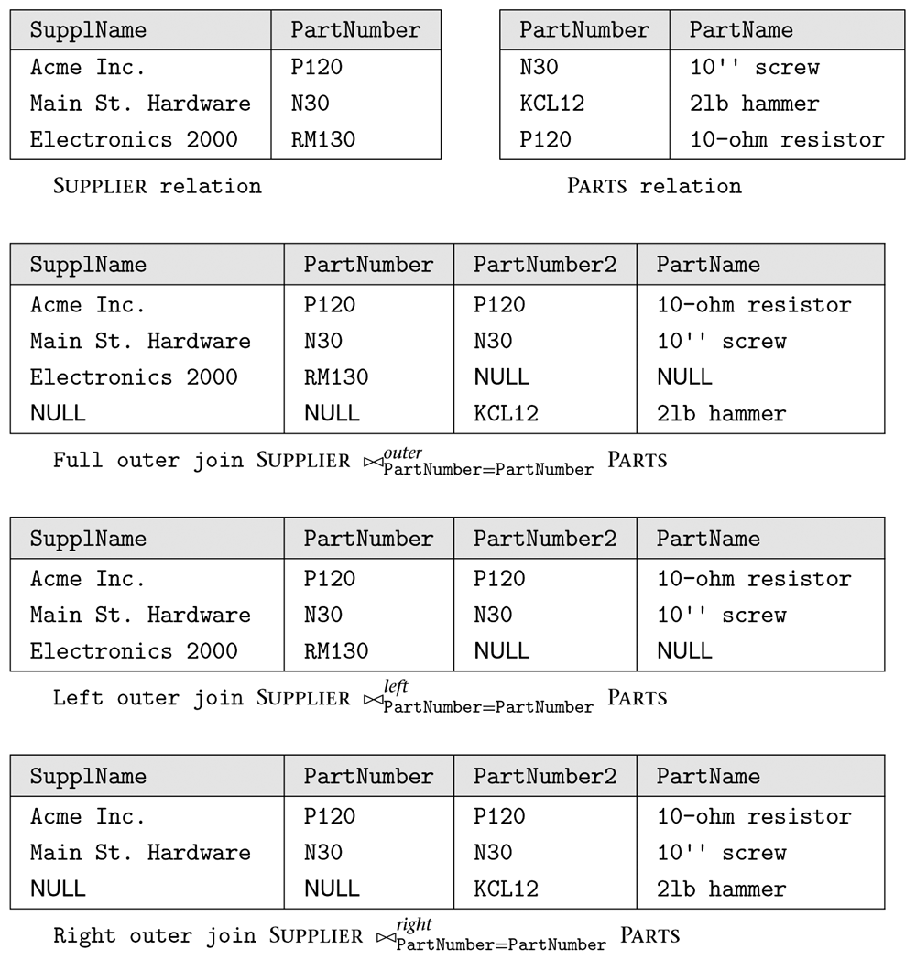
Outer joins Example
Figure 5.5
1-<number>

Slide 29
Outer joins
R S
  Contains three categories of tuples
    A: the tuples that appear in the regular join of R and S
    B: the tuples of R that does not join any tuples in S
      Padded with NULL over the attributes of S
    C: the tuples of S that does not join any tuples in R
      Padded with NULL over the attributes of R
  Full outer join
    A ∪ B ∪ C
  Left outer join
    A ∪ B
  Right outer join
    A∪C
outer
Join-condition
outer
Join-condition
Left
Join-condition
Right
Join-condition
1-<number>

Slide 30
Outer joins Example
Figure 5.5
1-<number>

Slide 31
Division
Goal: Produce the tuples in one relation, r, that match all tuples in another relation, s
  r (A₁, …A_{n}, B₁, …B_{m})
  s (B₁ …B_{m})
  r/s, with attributes A₁, …A_{n}, is the set of all tuples <a> such that for every tuple <b> in s, <a,b> is in r
Can be expressed in terms of projection, set difference, and cross-product
1-<number>

Slide 32
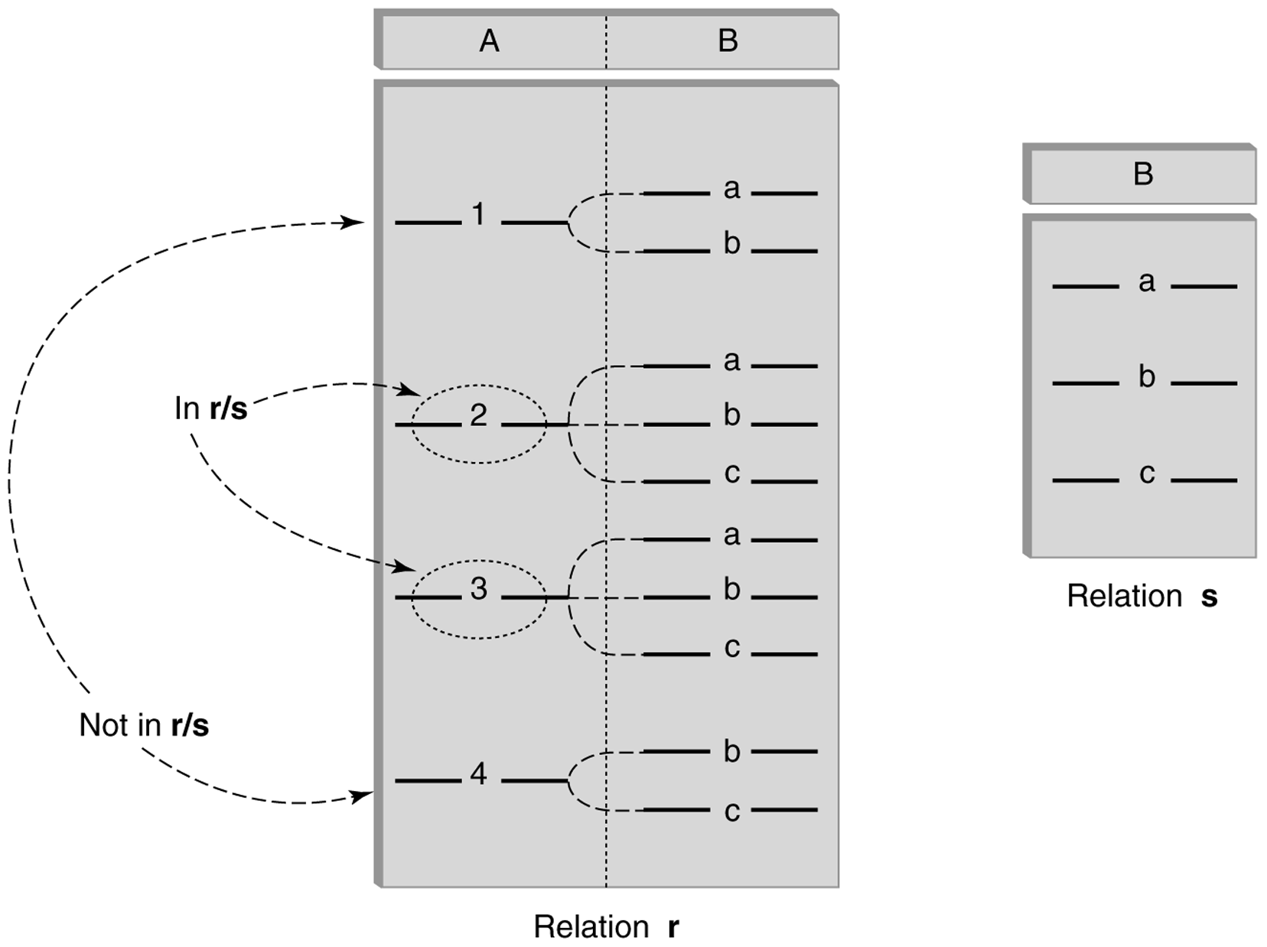
Division (cont’d)
1-<number>

Slide 33
Division - Example
List the Ids of students who have passed all courses that were taught in spring 2000
Numerator: 被除數 (分子)
  StudId and CrsCode for every course passed by every student:
  π_{StudId, CrsCode} (σ_{Grade≠ ‘F’} (Transcript) )
Denominator:除數(分母)
  CrsCode of all courses taught in spring 2000
  π_{CrsCode} (σ_{Semester=‘S2000’} (Teaching) )
Result is numerator/denominator
1-<number>

Slide 34
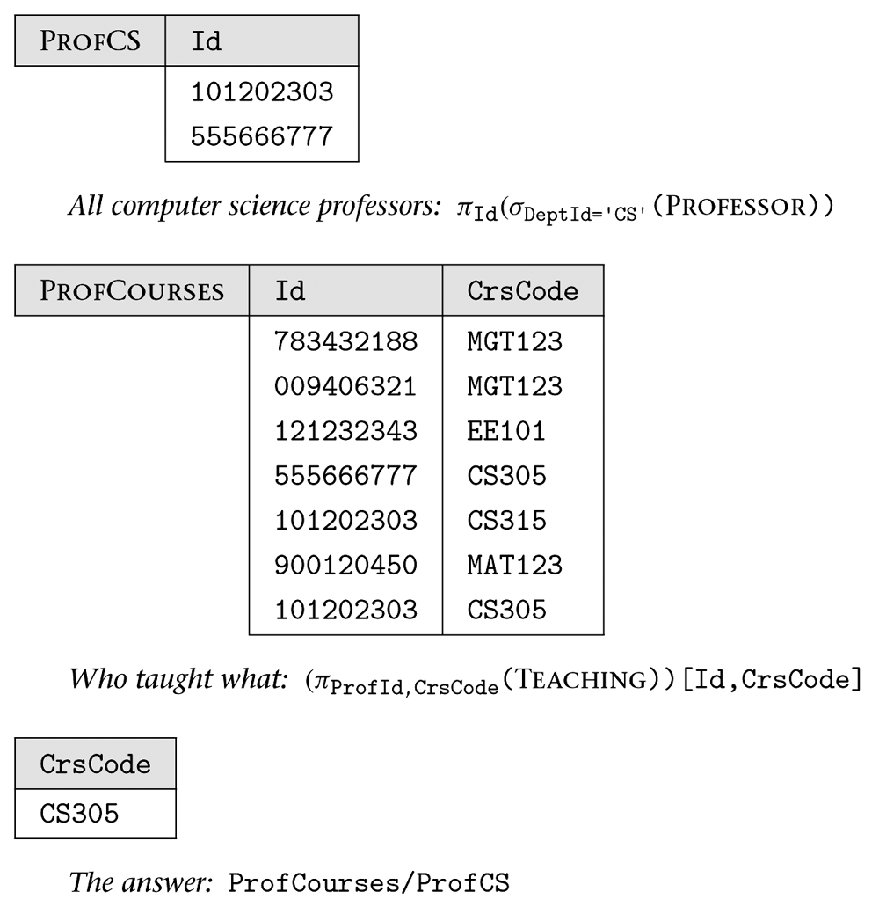
Figure 5.7 The anatomy of a query: Courses taught by every computer science professor
1-<number>

Slide 35
Schema for Student
Registration System
Student (Id, Name, Addr, Status)
Professor (Id, Name, DeptId)
Course (DeptId, CrsCode, CrsName, Descr)
Transcript (StudId, CrsCode, Semester, Grade)
Teaching (ProfId, CrsCode, Semester)
Department (DeptId, Name)
1-<number>

Slide 36
Query Sublanguage of SQL
SELECT C.CrsName
FROM Course C
WHERE C.DeptId = ‘CS’
Tuple variable C ranges over rows of Course.
  Table alias
Evaluation strategy:
  FROM clause produces Cartesian product of listed tables
    Step 1
  WHERE clause assigns rows to C in sequence and produces table containing only rows satisfying condition
    Step 2
  SELECT clause retains listed columns
    Step 3
Equivalent to: π_{CrsName}σ_{DeptId=‘CS’}(Course)
1-<number>

Slide 37
Join Queries
SELECT C.CrsName
FROM Course C, Teaching T
WHERE C.CrsCode=T.CrsCode AND T.Semester=‘S2000’
List CS courses taught in S2000
Tuple variables clarify meaning.
Join condition “C.CrsCode=T.CrsCode”
  relates facts to each other
Selection condition “ T.Semester=‘S2000’ ”
  eliminates irrelevant rows
Equivalent (using natural join) to:
π_{CrsName}(Course
σ_{Semester=‘S2000’} (Teaching) )
π_{CrsName} (σ_{Sem=‘S2000’} (Course Teaching) )
1-<number>

Slide 38
Correspondence Between SQL and Relational Algebra
SELECT C.CrsName
FROM Course C, Teaching T
WHERE C.CrsCode = T.CrsCode AND T.Semester = ‘S2000’
Also equivalent to:
π_{CrsName} σC_CrsCode=T_CrsCode AND Semester=‘S2000’
(Course [C_CrsCode, DeptId, CrsName, Desc]
× Teaching [ProfId, T_CrsCode, Semester])
This is the simplest evaluation algorithm for SELECT.
Relational algebra expressions are procedural.
  Which of the two equivalent expressions is more easily evaluated?
1-<number>

Slide 39
Self-join Queries
T1 T2
T1.ProfID | T1.CrsCode | T1.Semester
B13001 | CS0012 | S2010
B13005 | CS0010 | S2010
B13005 | CS0003 | S2010
B13002 | CS0010 | S2011
T2.ProfID | T2.CrsCode | T2.Semester
B13001 | CS0012 | S2010
B13005 | CS0010 | S2010
B13005 | CS0003 | S2010
B13002 | CS0010 | S2011
1-<number>

Slide 40
Self-join Queries
T1 X T2 //Cartesian product
T1.ProfID | T1.CrsCode | T1.Semester | T2.ProfID | T2.CrsCode | T2.Semester
B13001 | CS0012 | S2010 | B13001 | CS0012 | S2010
B13001 | CS0012 | S2010 | B13005 | CS0010 | S2010
B13001 | CS0012 | S2010 | B13005 | CS0003 | S2010
B13001 | CS0012 | S2010 | B13002 | CS0010 | S2011
B13005 | CS0010 | S2010 | B13001 | CS0012 | S2010
B13005 | CS0010 | S2010 | B13005 | CS0010 | S2010
B13005 | CS0010 | S2010 | B13005 | CS0003 | S2010
B13005 | CS0010 | S2010 | B13002 | CS0010 | S2011
B13005 | CS0003 | S2010 | B13001 | CS0012 | S2010
B13005 | CS0003 | S2010 | B13005 | CS0010 | S2010
B13005 | CS0003 | S2010 | B13005 | CS0003 | S2010
B13005 | CS0003 | S2010 | B13002 | CS0010 | S2011
B13002 | CS0010 | S2011 | B13001 | CS0012 | S2010
B13002 | CS0010 | S2011 | B13005 | CS0010 | S2010
B13002 | CS0010 | S2011 | B13005 | CS0003 | S2010
B13002 | CS0010 | S2011 | B13002 | CS0010 | S2011
1-<number>

Slide 41
Self-join Queries
T1 T1.ProfId = T2.ProfId AND T1.Semester = T2.Semester AND T1.CrsCode <> T2.CrsCode T2
T1.ProfID | T1.CrsCode | T1.Semester | T2.ProfID | T2.CrsCode | T2.Semester
B13001 | CS0012 | S2010 | B13001 | CS0012 | S2010
B13001 | CS0012 | S2010 | B13005 | CS0010 | S2010
B13001 | CS0012 | S2010 | B13005 | CS0003 | S2010
B13001 | CS0012 | S2010 | B13002 | CS0010 | S2011
B13005 | CS0010 | S2010 | B13001 | CS0012 | S2010
B13005 | CS0010 | S2010 | B13005 | CS0010 | S2010
B13005 | CS0010 | S2010 | B13005 | CS0003 | S2010
B13005 | CS0010 | S2010 | B13002 | CS0010 | S2011
B13005 | CS0003 | S2010 | B13001 | CS0012 | S2010
B13005 | CS0003 | S2010 | B13005 | CS0010 | S2010
B13005 | CS0003 | S2010 | B13005 | CS0003 | S2010
B13005 | CS0003 | S2010 | B13002 | CS0010 | S2011
B13002 | CS0010 | S2011 | B13001 | CS0012 | S2010
B13002 | CS0010 | S2011 | B13005 | CS0010 | S2010
B13002 | CS0010 | S2011 | B13005 | CS0003 | S2010
B13002 | CS0010 | S2011 | B13002 | CS0010 | S2011
1-<number>

Slide 42
Self-join Queries
Find Ids of all professors who taught at least two courses in the same semester:
SELECT T1.ProfId
FROM Teaching T1, Teaching T2
WHERE T1.ProfId = T2.ProfId
AND T1.Semester = T2.Semester
AND T1.CrsCode <> T2.CrsCode
Tuple variables are essential in this query!
Equivalent to:
π_{ProfId} (σ_{T1.CrsCode≠T2.CrsCode}(Teaching[ProfId, T1.CrsCode, Semester]
Teaching[ProfId, T2.CrsCode, Semester]))
1-<number>

Slide 43
Duplicates
Duplicate rows not allowed in a relation
However, duplicate elimination from query result is costly and not done by default; must be explicitly requested:
SELECT DISTINCT …..
FROM …..
1-<number>

Slide 44
Use of Expressions
Equality and comparison operators apply to strings (based on lexical ordering)
WHERE S.Name < ‘P’
Concatenate operator applies to strings
WHERE S.Name || ‘--’ || S.Address = ….
Expressions can also be used in SELECT clause:
SELECT S.Name || ‘--’ || S.Address AS NmAdd
FROM Student S
1-<number>

Slide 45
Set Operators
SQL provides UNION, EXCEPT (set difference), and INTERSECT for union compatible tables
Example: Find all professors in the CS Department and all professors that have taught CS courses
(SELECT P.Name
FROM Professor P, Teaching T
WHERE P.Id=T.ProfId AND T.CrsCode LIKE ‘CS%’)
UNION
(SELECT P.Name
FROM Professor P
WHERE P.DeptId = ‘CS’)
1-<number>

Slide 46
Nested Queries
List all courses that were not taught in S2000
SELECT C.CrsName
FROM Course C
WHERE C.CrsCode NOT IN
(SELECT T.CrsCode --subquery
FROM Teaching T
WHERE T.Sem = ‘S2000’)
Evaluation strategy: subquery evaluated once to
produces set of courses taught in S2000. Each row
(as C) tested against this set.
1-<number>

Slide 47
Schema for Student
Registration System
Student (Id, Name, Addr, Status)
Professor (Id, Name, DeptId)
Course (DeptId, CrsCode, CrsName, Descr)
Transcript (StudId, CrsCode, Semester, Grade)
Teaching (ProfId, CrsCode, Semester)
Department (DeptId, Name)
1-<number>

Slide 48
Correlated Nested Queries
Output a row <prof, dept> if prof has taught a course
in dept.
SELECT P.Name, D.Name --outer query
FROM Professor P, Department D
WHERE P.Id IN
-- set of all ProfId’s who have taught a course in D.DeptId
(SELECT T.ProfId --subquery
FROM Teaching T, Course C
WHERE T.CrsCode=C.CrsCode AND
C.DeptId=D.DeptId --correlation
)
1-<number>

Slide 49
Correlated Nested Queries (con’t)
Tuple variables T and C are local to subquery
Tuple variables P and D are global to subquery
Correlation: subquery uses a global variable, D
The value of D.DeptId parameterizes an evaluation of the subquery
Subquery must (at least) be re-evaluated for each distinct value of D.DeptId
Correlated queries can be expensive to evaluate
1-<number>

Slide 50
Division in SQL
Query type: Find the subset of items in one set that are related to all items in another set
Example: Find professors who taught courses in all departments
  Why does this involve division?
ProfId DeptId
DeptId
Contains row
<p,d> if professor
p taught a
course in
department d
All department Ids
π_{ProfId,DeptId}(Teaching Course) / π_{DeptId}(Department)
1-<number>

Slide 51
Division – SQL Solution
SELECT P.Id
FROM Professor P
WHERE NOT EXISTS
(SELECT D.DeptId -- set B of all dept Ids
FROM Department D
EXCEPT
SELECT C.DeptId -- set A of dept Ids of depts in
-- which P taught a course
FROM Teaching T, Course C
WHERE T.ProfId=P.Id -- global variable
AND T.CrsCode=C.CrsCode)
1-<number>

Slide 52
Division in SQL
Strategy for implementing division in SQL:
  Find set, A, of all departments in which a particular professor, p, has taught a course
  Find set, B, of all departments
  Output p if A ⊇ B, or, equivalently, if B–A is empty
1-<number>

Slide 53
Aggregates
Functions that operate on sets:
  COUNT, SUM, AVG, MAX, MIN
Produce numbers (not tables)
Not part of relational algebra (but not hard to add)
SELECT COUNT(*)
FROM Professor P
SELECT MAX (Salary)
FROM Employee E
SELECT COUNT(*) AS NumPro
FROM Professor P
SELECT MAX (Salary) AS MaxSal
FROM Employee E
1-<number>

Slide 54
Aggregates (cont’d)
Count the number of courses taught in S2000
SELECT COUNT (T.CrsCode) AS NumCrs
FROM Teaching T
WHERE T.Semester = ‘S2000’
But if multiple sections of same course
are taught, use:
SELECT COUNT (DISTINCT T.CrsCode)
FROM Teaching T
WHERE T.Semester = ‘S2000’
1-<number>

Slide 55
Grouping
But how do we compute the number of courses taught in S2000 per professor?
  Strategy 1: Fire off a separate query for each professor:
SELECT COUNT(T.CrsCode)
FROM Teaching T
WHERE T.Semester = ‘S2000’ AND T.ProfId = 123456789
    Cumbersome
    What if the number of professors changes? Add another query?
  Strategy 2: define a special grouping operator:
SELECT T.ProfId, COUNT(T.CrsCode)
FROM Teaching T
WHERE T.Semester = ‘S2000’
GROUP BY T.ProfId
1-<number>

Slide 56
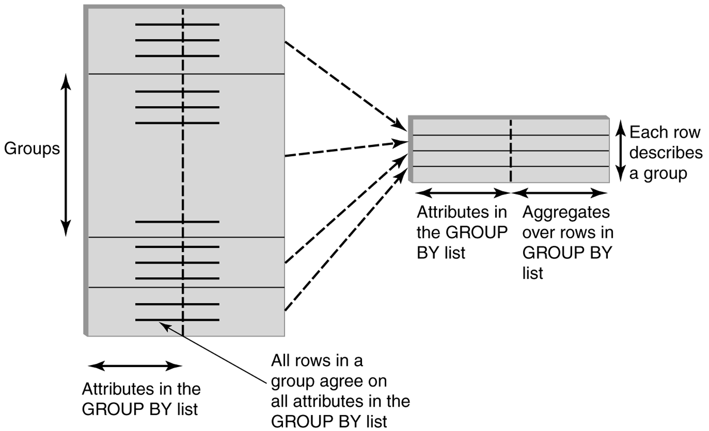
GROUP BY
1-<number>

Slide 57
GROUP BY - Example
Transcript
Attributes:
–student’s Id
–avg grade
–number of courses
1234
1234
1234
1234
1234 3.3 4
SELECT T.StudId, AVG(T.Grade), COUNT (*)
FROM Transcript T
GROUP BY T.StudId
1-<number>

Slide 58
HAVING Clause
Eliminates unwanted groups (analogous to WHERE clause, but works on groups instead of individual tuples)
HAVING condition is constructed from attributes of GROUP BY list and aggregates on attributes not in that list
SELECT T.StudId,
AVG(T.Grade) AS CumGpa,
COUNT (*) AS NumCrs
FROM Transcript T
WHERE T.CrsCode LIKE ‘CS%’
GROUP BY T.StudId
HAVING AVG (T.Grade) > 3.5
1-<number>

Slide 59
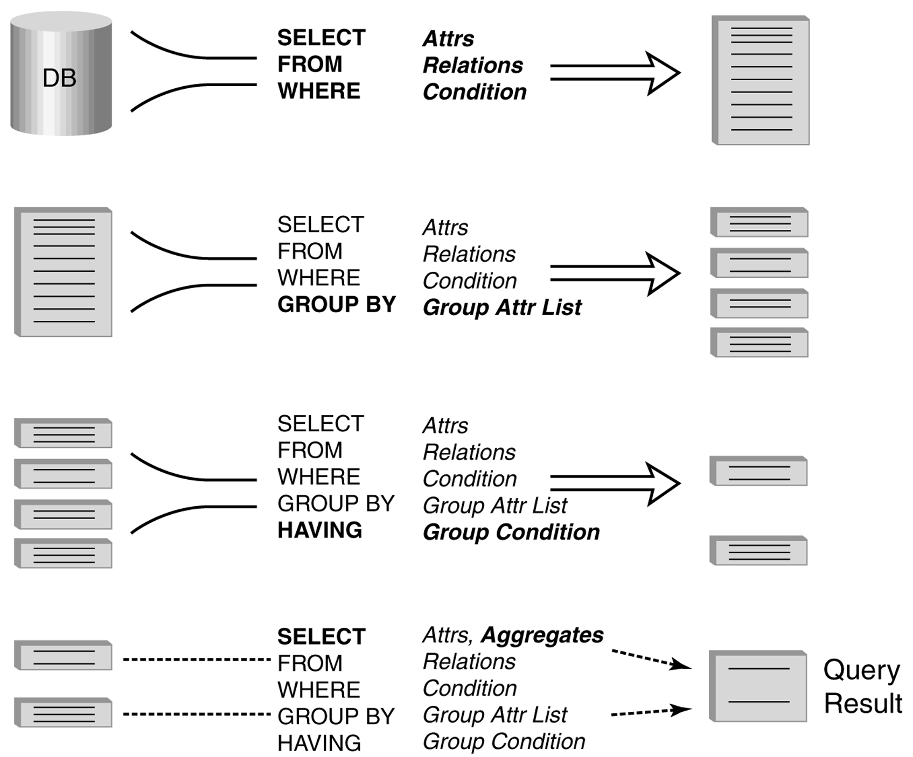
Evaluation of GroupBy with Having
1-<number>

Slide 60
Example
Output the Id and name of all seniors on the Dean’s List
SELECT S.Id, S.Name
FROM Student S, Transcript T
WHERE S.Id = T.StudId AND S.Status = ‘senior’
GROUP BY
HAVING AVG (T.Grade) > 3.5 AND SUM (T.Credit) > 90
Every attribute that occurs in SELECT clause must also occur in GROUP BY or it must be an aggregate. S.Name does not.
S.Id -- wrong
S.Id, S.Name -- right
1-<number>

Slide 61
Aggregates: Proper and Improper Usage
SELECT COUNT (T.CrsCode), T. ProfId
– makes no sense (in the absence of
GROUP BY clause)
SELECT COUNT (*), AVG (T.Grade)
– but this is OK
WHERE T.Grade > COUNT (SELECT ….)
– aggregate cannot be applied to result
of SELECT statement
1-<number>

Slide 62
ORDER BY Clause
Causes rows to be output in a specified order
SELECT T.StudId, COUNT (*) AS NumCrs,
AVG(T.Grade) AS CumGpa
FROM Transcript T
WHERE T.CrsCode LIKE ‘CS%’
GROUP BY T.StudId
HAVING AVG (T.Grade) > 3.5
ORDER BY DESC CumGpa, ASC StudId
Descending
Ascending
1-<number>

Slide 63
Query Evaluation with
GROUP BY, HAVING, ORDER BY
Evaluate FROM: produces Cartesian product, A, of tables in FROM list
Evaluate WHERE: produces table, B, consisting of rows of A that satisfy WHERE condition
Evaluate GROUP BY: partitions B into groups that agree on attribute values in GROUP BY list
Evaluate HAVING: eliminates groups in B that do not satisfy HAVING condition
Evaluate SELECT: produces table C containing a row for each group. Attributes in SELECT list limited to those in GROUP BY list and aggregates over group
Evaluate ORDER BY: orders rows of C
A s b e f o r e
1-<number>

Slide 64
Views
Used as a relation, but rows are not physically stored.
  The contents of a view is computed when it is used within an SQL statement
View is the result of a SELECT statement over other views and base relations
When used in an SQL statement, the view definition is substituted for the view name in the statement
  As SELECT statement nested in FROM clause
1-<number>

Slide 65
View - Example
CREATE VIEW CumGpa (StudId, Cum) AS
SELECT T.StudId, AVG (T.Grade)
FROM Transcript T
GROUP BY T.StudId
SELECT S.Name, C.Cum
FROM CumGpa C, Student S
WHERE C.StudId = S.StudId AND C.Cum > 3.5
1-<number>

Slide 66
View Benefits
Access Control: Users not granted access to base tables. Instead they are granted access to the view of the database appropriate to their needs.
  External schema is composed of views.
  View allows owner to provide SELECT access to a subset of columns (analogous to providing UPDATE and INSERT access to a subset of columns)
1-<number>

Slide 67
Views – Limiting Visibility
Grade projected out
CREATE VIEW PartOfTranscript (StudId, CrsCode, Semester) AS
SELECT T. StudId, T.CrsCode, T.Semester -- limit columns
FROM Transcript T
WHERE T.Semester = ‘S2000’ -- limit rows
Give permissions to access data through view:
GRANT SELECT ON PartOfTranscript TO joe
This would have been analogous to:
GRANT SELECT (StudId,CrsCode,Semester)
ON Transcript TO joe
on regular tables, if SQL allowed attribute lists in GRANT SELECT
1-<number>

Slide 68
View Benefits (cont’d)
Customization: Users need not see full complexity of database. View creates the illusion of a simpler database customized to the needs of a particular category of users
A view is similar in many ways to a subroutine in standard programming
  Can be reused in multiple queries
1-<number>

Slide 69
Nulls
Conditions: x op y (where op is <, >, <>, =, etc.) has value unknown (U) when either x or y is null
  WHERE T.cost > T.price
Arithmetic expression: x op y (where op is +, –, *, etc.) has value NULL if x or y is NULL
  WHERE (T. price/T.cost) > 2
Aggregates: COUNT counts NULLs like any other value; other aggregates ignore NULLs
SELECT COUNT (T.CrsCode), AVG (T.Grade)
FROM Transcript T
WHERE T.StudId = ‘1234’
1-<number>

Slide 70
Nulls (cont’d)
WHERE clause uses a three-valued logic – T, F, U(ndefined) – to filter rows. Portion of truth table:
Rows are discarded if WHERE condition is F(alse) or U(nknown)
Ex: WHERE T.CrsCode = ‘CS305’ AND T.Grade > 2.5
C1 C2 C1 AND C2 C1 OR C2
T U U T
F U F U
U U U U
1-<number>

Slide 71
Modifying Tables – Insert
Inserting a single row into a table
  Attribute list can be omitted if it is the same as in CREATE TABLE (but do not omit it)
  NULL and DEFAULT values can be specified
INSERT INTO Transcript(StudId, CrsCode, Semester, Grade)
VALUES (12345, ‘CSE305’, ‘S2000’, NULL)
1-<number>

Slide 72
Bulk Insertion
Insert the rows output by a SELECT
CREATE TABLE DeansList (
StudId INTEGER,
Credits INTEGER,
CumGpa FLOAT,
PRIMARY KEY StudId )
INSERT INTO DeansList (StudId, Credits, CumGpa)
SELECT T.StudId, 3 * COUNT (*), AVG(T.Grade)
FROM Transcript T
GROUP BY T.StudId
HAVING AVG (T.Grade) > 3.5 AND COUNT(*) > 30
1-<number>

Slide 73
Modifying Tables – Delete
Similar to SELECT except:
  No project list in DELETE clause
  No Cartesian product in FROM clause (only 1 table name)
  Rows satisfying WHERE clause (general form, including subqueries, allowed) are deleted instead of output
DELETE FROM Transcript T
WHERE T.Grade IS NULL AND T.Semester <> ‘S2000’
1-<number>

Slide 74
Modifying Data - Update
UPDATE Employee E
SET E.Salary = E.Salary * 1.05
WHERE E.Department = ‘R&D’
Updates rows in a single table
All rows satisfying WHERE clause (general form, including subqueries, allowed) are updated
1-<number>

Slide 75
Updating Views
Question: Since views look like tables to users, can they be updated?
Answer: Yes – a view update changes the underlying base table to produce the requested change to the view
CREATE VIEW CsReg (StudId, CrsCode, Semester) AS
SELECT T.StudId, T. CrsCode, T.Semester
FROM Transcript T
WHERE T.CrsCode LIKE ‘CS%’ AND T.Semester=‘S2000’
1-<number>

Slide 76
Updating Views - Problem 1
INSERT INTO CsReg (StudId, CrsCode, Semester)
VALUES (1111, ‘CSE305’, ‘S2000’)
Question: What value should be placed in attributes of underlying table that have been projected out (e.g., Grade)?
Answer: NULL (assuming null allowed in the missing attribute) or DEFAULT
1-<number>

Slide 77
Updating Views - Problem 2
INSERT INTO CsReg (StudId, CrsCode, Semester)
VALUES (1111, ‘ECO105’, ‘S2000’)
Problem: New tuple not in view
Solution: Allow insertion (assuming the WITH CHECK OPTION clause has not been appended to the CREATE VIEW statement)
1-<number>

Slide 78
Updating Views - Problem 3
Update to a view might not uniquely specify the change to the base table(s) that results in the desired modification of the view (ambiguity)
CREATE VIEW ProfDept (PrName, DeName) AS
SELECT P.Name, D.Name
FROM Professor P, Department D
WHERE P.DeptId = D.DeptId
1-<number>

Slide 79
Updating Views - Problem 3 (cont’d)
Tuple <Smith, CS> can be deleted from ProfDept by:
  Deleting row for Smith from Professor (but this is inappropriate if he is still at the University)
  Deleting row for CS from Department (not what is intended)
  Updating row for Smith in Professor by setting DeptId to null (seems like a good idea, but how would the computer know?)
1-<number>

Slide 80
Updating Views - Restrictions
Updatable views are restricted to those in which
  No Cartesian product in FROM clause
  no aggregates, GROUP BY, HAVING
  …
For example, if we allowed:
CREATE VIEW AvgSalary (DeptId, Avg_Sal ) AS
SELECT E.DeptId, AVG(E.Salary)
FROM Employee E
GROUP BY E.DeptId
then how do we handle:
UPDATE AvgSalary
SET Avg_Sal = 1.1 * Avg_Sal
1-<number>

